Slide 1


LAKE CONFERENCE 2022
Observation and Documentation of
Moth Diversity in Weavers Colony
Team
Lakshita K, Hemashree K Class 9

Slide 2
INTRODUCTION
Moths are important among pollinators particularly they are active after dark, when many other pollinating animals have settled down for the night.
Adult moths and their caterpillars are important food for a wide variety of wildlife,
Moth requires food in liquid. Moth are jewels of night, they mainly get attracted to light
Moths fold their wings tent like over the body or wrap them around the body.

Slide 3
Objectives: Observation and Documentation of
Moth in Weavers Colony
Study Site:
Sl No | Site | Latitude | Longitude | Documented by
1 | 1st cross | 12°84'49"N | 77°58'55"E | Namitha
2 | 3rd cross | 12°84'32"N | 77°58'38"E | Yashaswini I
3 | 5th cross | 12°84'52"N | 77°58'43"E | Manohar
4 | 7th cross | 12°84'51"N | 77°58'35"E | Deepthi A
5 | 9th cross (N) | 12°84'76"N | 77°58'37"E | Lakshita K
6 | 9th cross (S) | 12°84'48"N | 77°58'25"E | Nayana
7 | 12th cross (N) | 12°84'66"N | 77°58'14"E | Lekhana S
8 | 12th cross (S) | 12°84'60"N | 77°58'12"E | Sanjana K
9 | 13th cross | 12°84'85"N | 77°58'11"E | Hemashree K

Slide 4
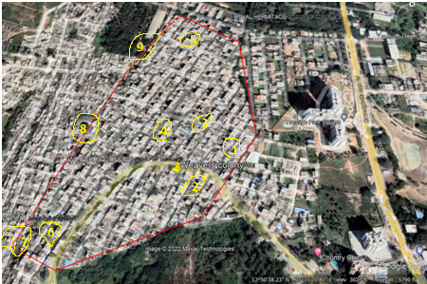
Study Area:
Weavers Colony, Bengaluru south, Gottigere Post,
Bannerughatta Road, Bengaluru – 560083

Slide 5
Materials and Methods:
Selected study area is around 2 Km
A white dhoti’s (thin white cloth of 3feet x 6feet ) top edges was tied and few plants were kept around it and a light trap was fixed for the study.
Light was left on whole night and Observation was made between 5.00am to 6.30am and 9.00pm to 10.30pm during July to November- 2022.
Indentified the Moths through visual methods

Slide 6
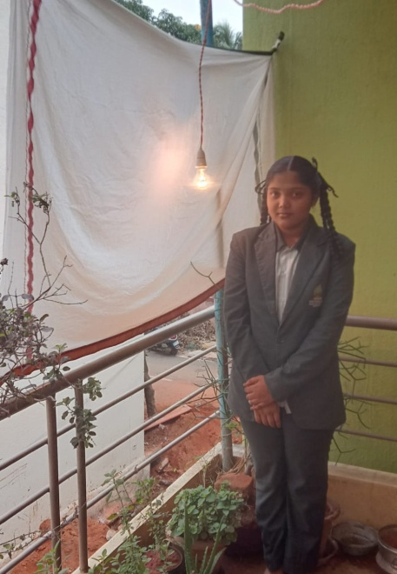

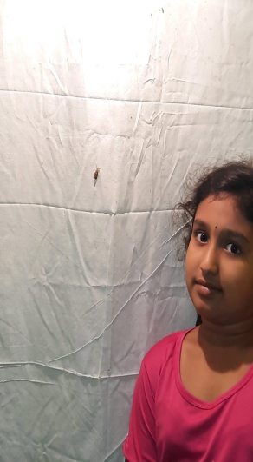
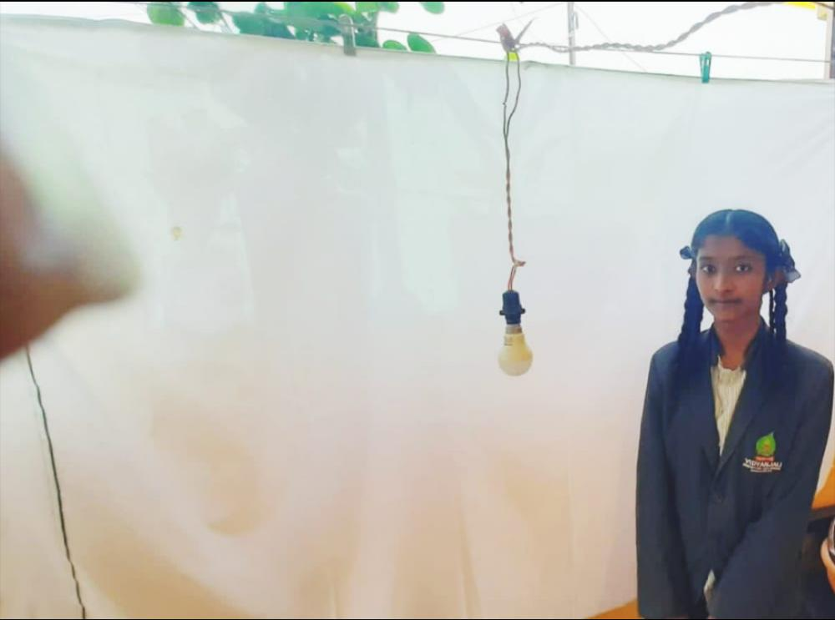

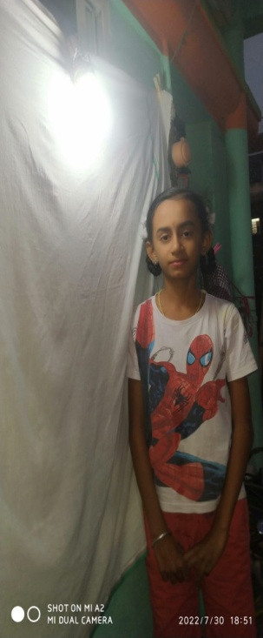
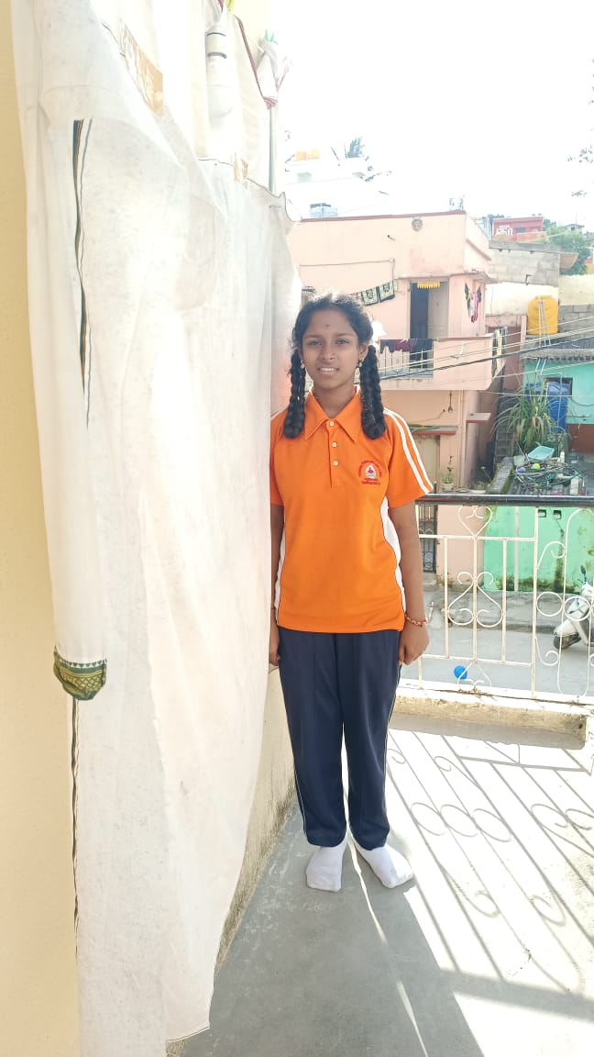
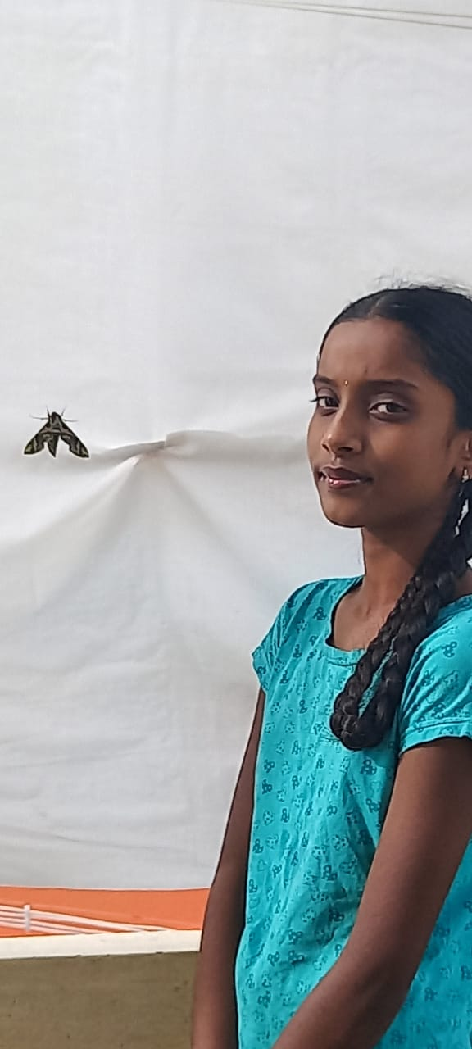
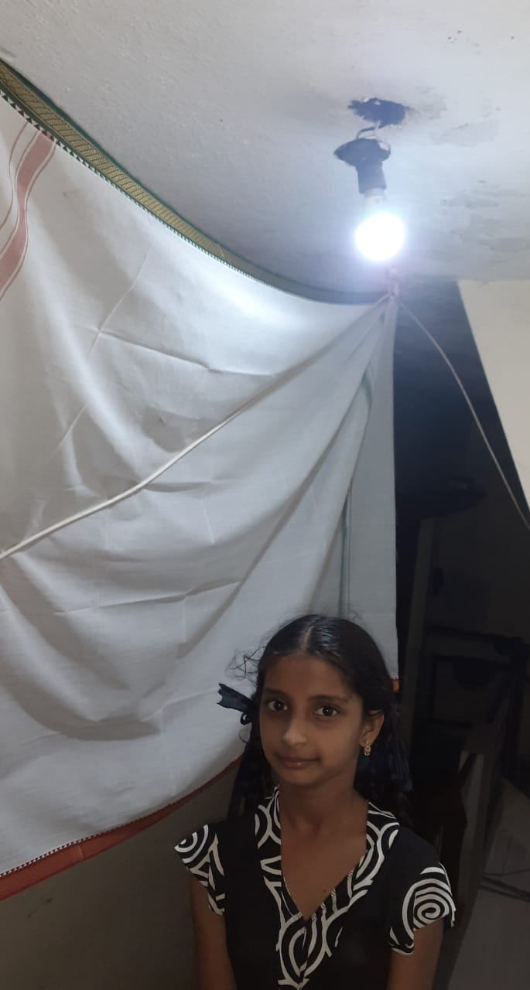
9 Study sites

Slide 7
Results and Discussion:
We documented Totally 37 species belonging to 9 families of moth.
Erebidae family was the largest represented by 13 species
We found Moss Footman [Nepita conferta] as a common moth in our study area.
By identifying the various moths we understood that moths are very well attracted to light and host plants,

Slide 8
Moth found in month wise
SL NO | MONTH | Species
1 | JULY | 21
2 | AUGUST | 24
3 | SEPTEMBER | 30
4 | OCTOBER | 22
5 | NOVEMBER | 25

Slide 9
Moth species documented monthly in various study sites
Sl No | Site | Latitude | Longitude | July | Aug | Sept | Oct | Nov
1 | 1st cross | 12°84'49"N | 77°58'55"E | 2 | 3 | 4 | 3 | 2
2 | 3rd cross | 12°84'32"N | 77°58'38"E | 4 | 2 | 3 | 2 | 4
3 | 5th cross | 12°84'52"N | 77°58'43"E | 3 | 12 | 7 | 4 | 6
4 | 7th cross | 12°84'51"N | 77°58'35"E | 2 | 2 | 3 | 2 | 2
5 | 9th cross (N) | 12°84'76"N | 77°58'37"E | 3 | 2 | 8 | 4 | 6
6 | 9th cross (S) | 12°84'48"N | 77°58'25"E | 2 | 3 | 2 | 2 | 4
7 | 12th cross (N) | 12°84'66"N | 77°58'14"E | 9 | 9 | 4 | 5 | 6
8 | 12th cross (S) | 12°84'60"N | 77°58'12"E | 2 | 2 | 2 | 3 | 2
9 | 13th cross | 12°84'85"N | 77°58'11"E | 2 | 3 | 3 | 2 | 2

Slide 10
Moth species documented monthly in various study sites

Slide 11
Checklist of Moths documented at weavers colony
SL No. | Common Name | Scientific Name | Family | July | Aug | Sep | Oct | Nov
1 | Buff silk moth | Bombyx mori | Bombycidae | 1 | 0 | 0 | 1 | 1
2 | Beet webworm | Spoladea recurvalis | Crambidae | 13 | 14 | 13 | 11 | 8
3 | Eggplant stem | Leucinodes orbonalis | Crambidae | 1 | 0 | 1 | 1 | 1
4 | Mother of pearl | Pathania ruralis | Crambidae | 1 | 1 | 1 | 0 | 1
5 | Yellow stem borer | Scirpophaga incertulas | Crambidae | 4 | 1 | 1 | 0 | 1
6 | Small magpie | Anania hortulata | Crambidae | 1 | 0 | 1 | 1 | 0
7 | Moss footman | Nepita conferta | Erebidae | 26 | 22 | 31 | 15 | 10
8 | Common owlet | Spirama retarta | Erebidae | 0 | 0 | 2 | 1 | 1
9 | Scarce footman | Manulea discalis | Erebidae | 0 | 1 | 1 | 1 | 1
10 | Snouted tiger | Asota plana | Erebidae | 0 | 1 | 1 | 1 | 1
11 | Toxic tiger | Carales arizonensis | Erebidae | 1 | 0 | 1 | 1 | 1
12 | Pink tiger | Spilosoma latipennis | Erebidae | 1 | 1 | 1 | 0 | 1
13 | Cyana moth | Cyana peregrina | Erebidae | 1 | 2 | 1 | 0 | 0
14 | Heliotrope | Utetheisa pulchelloides | Erebidae | 1 | 2 | 2 | 1 | 1
15 | Leopard moth | Hypercompe scribonia | Erebidae | 0 | 0 | 1 | 1 | 1

Slide 12
16 | Common fungus | Metalectra discalis | Erebidae | 0 | 1 | 1 | 1 | 1
17 | Yellow tussock | Dasychira basiflapa | Erebidae | 1 | 1 | 1 | 0 | 0
18 | Under wing moth | Catocola Sp. | Erebidae | 0 | 1 | 1 | 1 | 0
19 | Yellow tail tussock | Somena scintillans | Erebidae | 1 | 2 | 1 | 0 | 0
20 | Broken leaf | Circopetes obtusata | Geometridae | 0 | 1 | 1 | 0 | 1
21 | Little chiasmia | Chiasmia emersaria | Geometridae | 0 | 0 | 1 | 1 | 1
22 | Omnivores looper | Sabulodes aegrotata | Geometridae | 1 | 1 | 1 | 0 | 0
23 | Siva lappet | Streblote siva | Lasiocampidae | 1 | 1 | 0 | 0 | 1
24 | Small leaf | Phyllodes mallicifolia | Lasiocampidae | 0 | 1 | 1 | 1 | 0
25 | Cramers passenger | Bastilla crameri | Noctuidae | 1 | 0 | 1 | 1 | 2
26 | Mouse moth | Amphipyra tragopoginis | Noctuidae | 0 | 1 | 1 | 1 | 0
27 | Green garden looper | Chrysodeixis eviosoma | Noctuidae | 1 | 0 | 0 | 1 | 1
28 | Triangular-striped | Chalciope mygdom | Noctuidae | 0 | 0 | 2 | 1 | 1
29 | Amyna moth | Amyna stricta | Noctuidae | 0 | 1 | 1 | 1 | 0
30 | Indian meal | Plodia interpunctella | Pyralidae | 0 | 1 | 2 | 0 | 0
31 | Bee moth | Aphomia sociell | Pyralidae | 1 | 1 | 1 | 0 | 0
32 | Grease moth | Aglossa pinguinalis | Pyralidae | 0 | 1 | 1 | 1 | 1
33 | Oleander hawk | Daphnis nerii | Sphingidae | 1 | 1 | 2 | 0 | 2
34 | Privet hawk | Sphinx ligustri | Sphingidae | 1 | 0 | 0 | 0 | 1
35 | Convolvulus hawk moth | Agrius convolvuli | Sphingidae | 0 | 0 | 0 | 0 | 1
36 | Crepuscular hawk moth | Nephele hespera | Sphingidae | 0 | 0 | 0 | 1 | 1
37 | Leaf roller moth | Tortric sp. | Tortricidae | 1 | 2 | 0 | 0 | 0

Slide 14

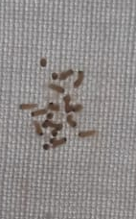
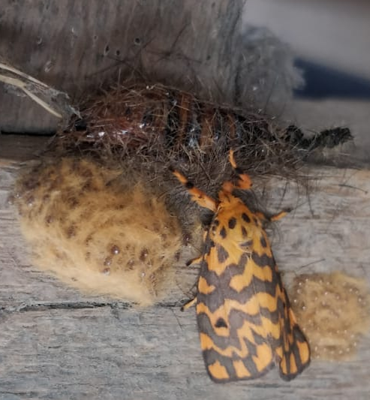
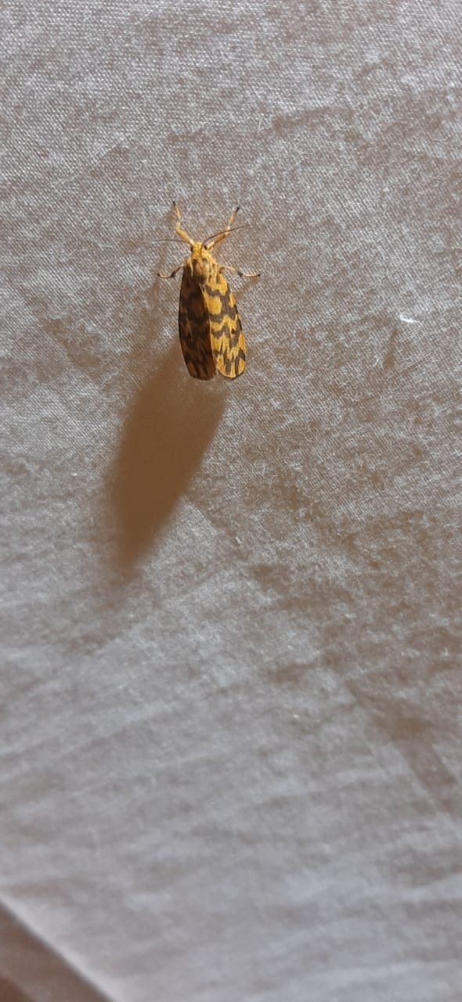
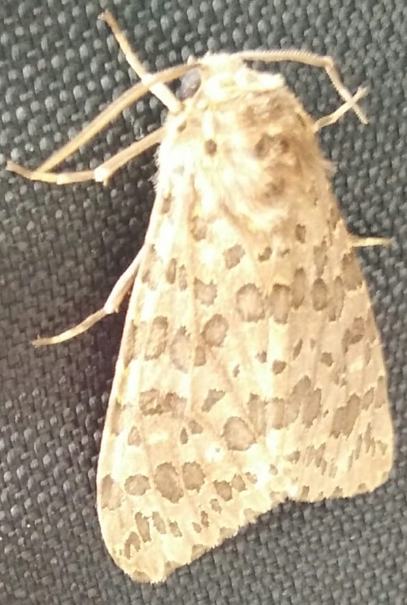
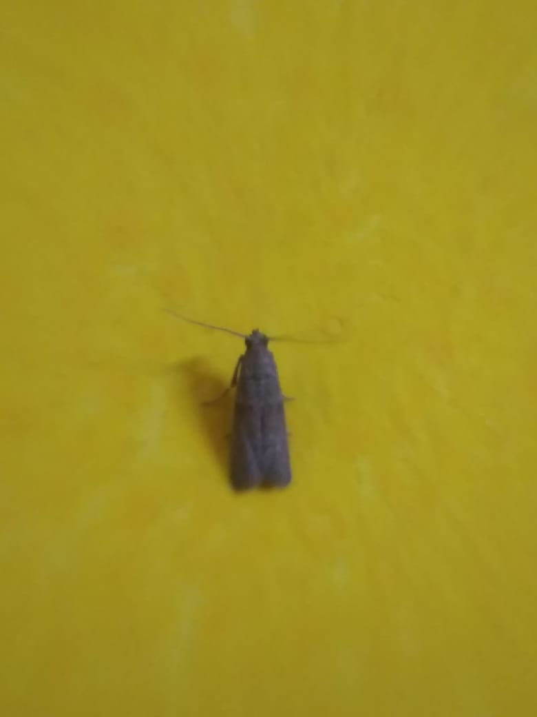
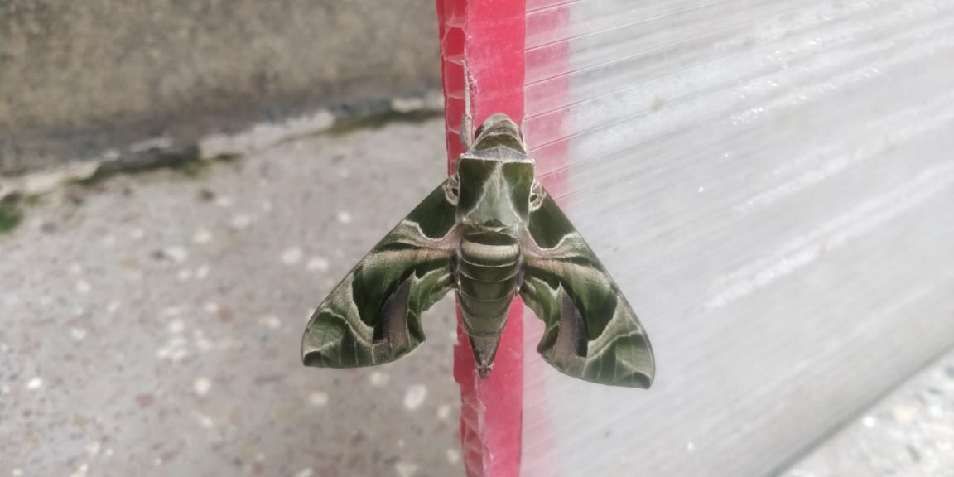
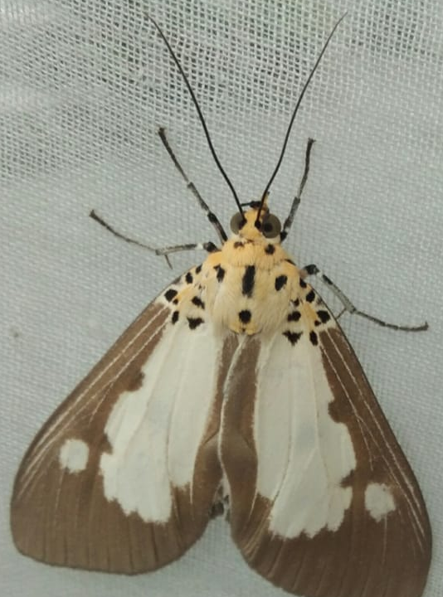
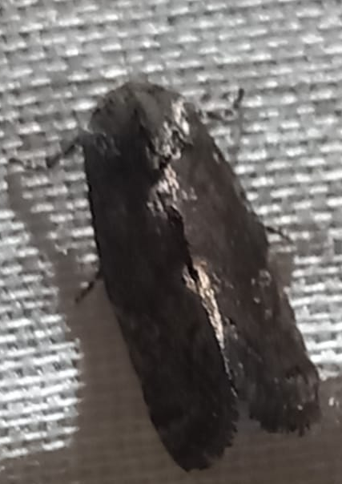
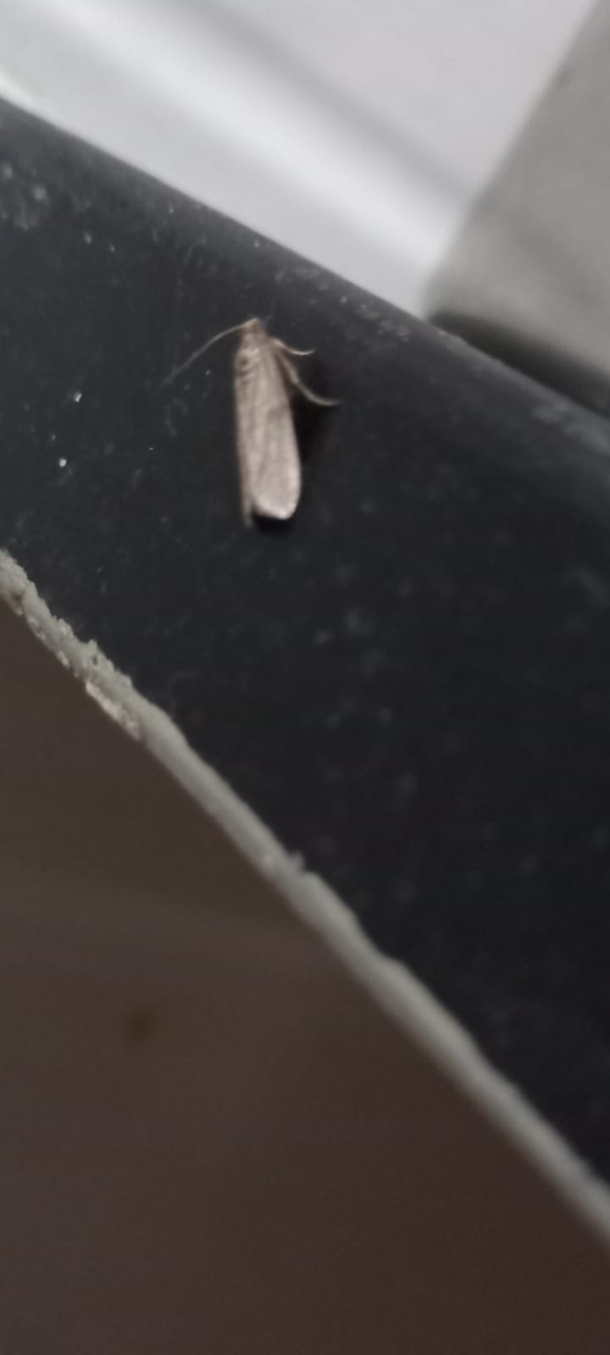
---------------Eggs--------------
Moss footman
Toxic tiger moth
Snouted tiger
moth
Mouse moth
Indian meal
moth
Yellow tail
tussock
Oleander hawk

Slide 15
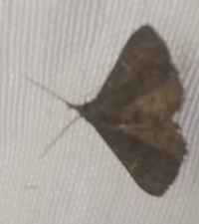
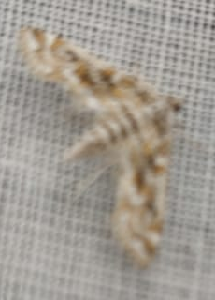
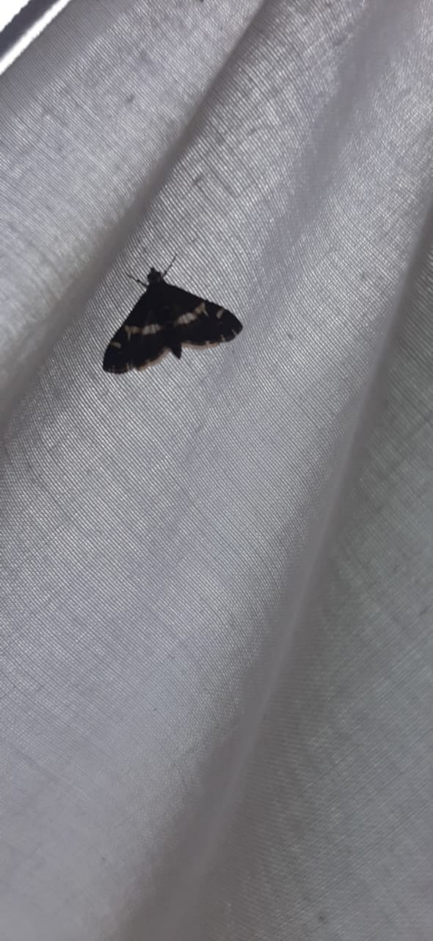
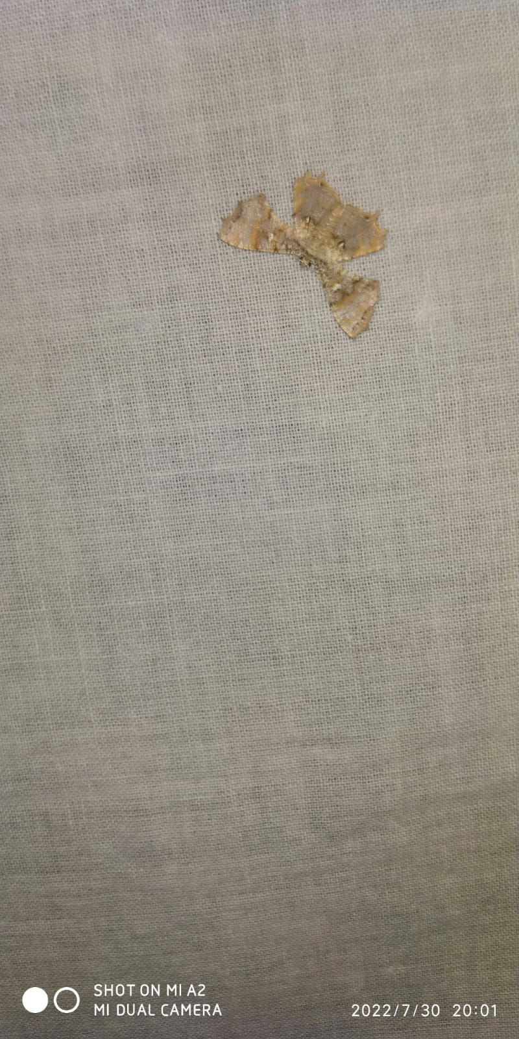
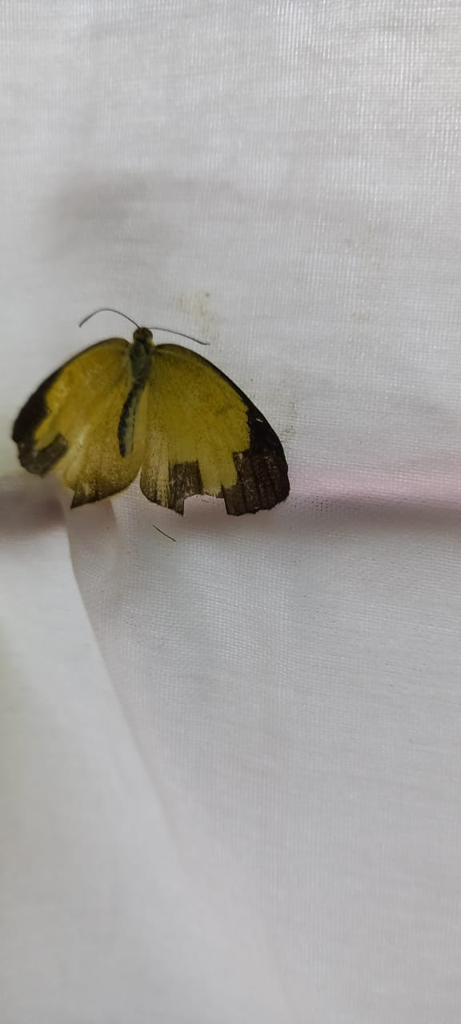
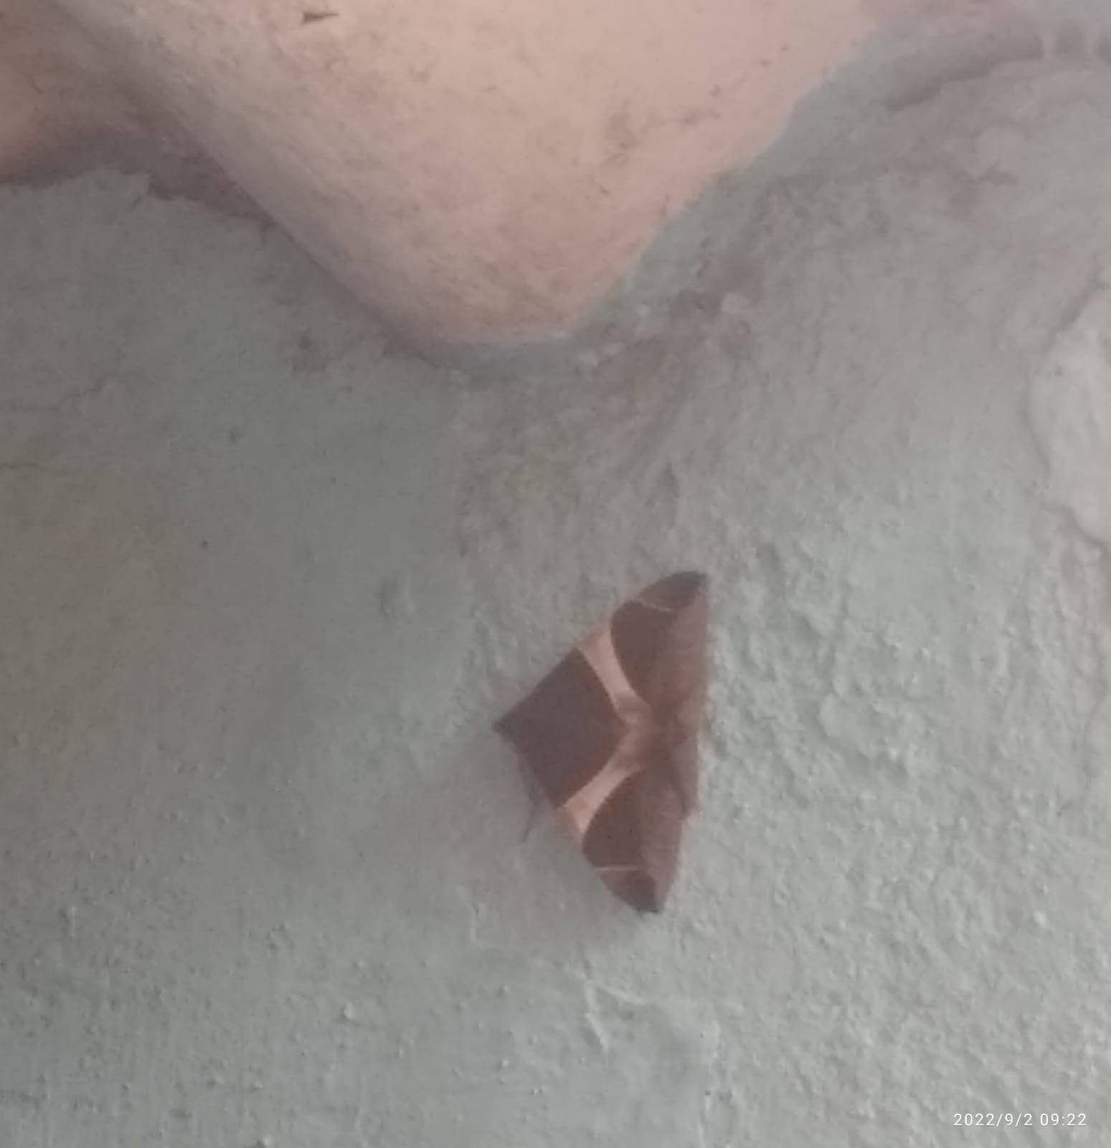
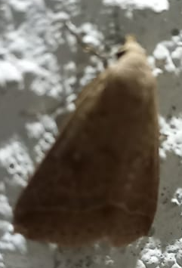
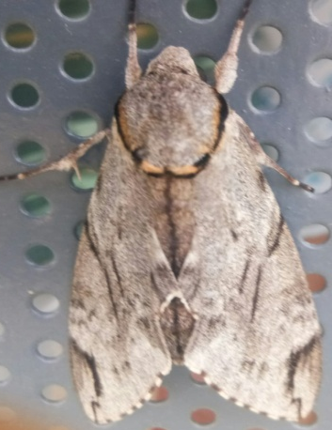
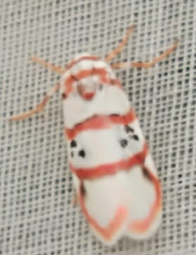
Beet web
worm
Small magpie
Small leaf
moth
unidentified
Orange sleepy
moth
Cramers
Passenger moth
Pink tiger
moth
Common owlet
moth
Cyana peregrina

Slide 16
Conclusion:
With this study we could identify 37 species of moth
in a period of 5 months from July to November 2022.
At 12th cross (N) we got 25 moth species and in
5th cross we could identify 23 moth species in our light traps.
We found least number of species in 1st and 7th cross
with 9 species of moths.
Among them Moss footman [Nepita conferta ] 94 and
Beet Webworm [Spaoladea recurvalis] 51 was the
maximum number of moths found
Privet hawk [Sphinx ligustri] and Buff silk moth [Bombyx mori]
were only seen twice in our study area.
By creating the environment of having plants near our study place
It is understood that these species are around our area.

Slide 17
Acknowledgement:
We thank our H.M, Guide Teacher for allowing us to conduct the Study.
We thank all the 9 members who all created the environment for
the moths in their houses and documented .
We thank Energy and Wetland Research Group,
Center for Ecology Science, Indian Institute of Science, Bangalore.
Shri Vriju lal of CEE and Shri Chaturved Shet R for guiding us.
We thank one and all here for giving us opportunity to present the Study.

Slide 18
Reference:
Moths of Bangalore-1, by Environmental Management and Policy Research Institute
Harish Bhat et all (2015) A Brochure of Eyes on Nature
published by Karnataka State Council for Science and Technology.
iNaturalist app
Moths of India.
For scientific name Wikipedia.

Slide 19
Thank You

